Slide 1
IMPROVING WASTE MGT IN AURANGABAD 2014
Almitra H Patel
Member, Supreme Court Committee for Solid Waste Management in Class 1 Cities
almitrapatel@rediffmail.com
www.almitrapatel.com

Slide 2
AURANGABAD MUST BECOME FULLY COMPLIANT WITH MSW RULES, STARTING TODAY
It requires unity and full from DC, Commissioner, Mayor and Councillors.
Public cooperation will follow.
Sindhi Colony is already a local model for cleanliness. Citizens decided they wanted a clean and healthy life and worked for it.
The Clean Cities Foundation can come and help AMC as they have done in other cities.

Slide 3
LAND FOR CENTRALISED WASTE MGT IS A PROBLEM HERE
So DECENTRALISED Waste Management is needed: Zone level, Ward level or on-site for Bulk generators of waste like hotels, apts, party halls.
For ALL Waste Mgt, it is absolutely necessary to KEEP WASTES UNMIXED: Food waste free of Plastic etc.
Then WET waste can become Manure for farms
DRY waste like plastics can be recycled, and hardly 10% needs final disposal anywhere.

Slide 4
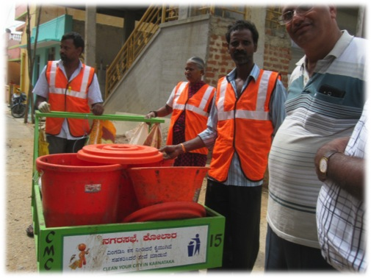
KOLAR HAS NO WASTE-MGT SITE.
CCF HELPED WITH 100% DOOR-TO-DOOR WASTE, SORTED AT DOORSTEP

Slide 5
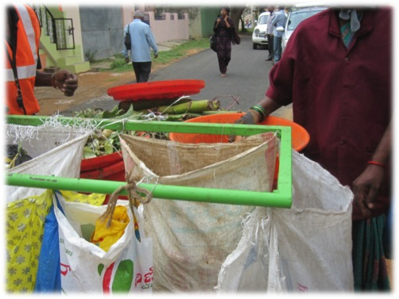
2-Person teams cover 4-500 homes, 6:30-10:30 am and keep sale proceeds of Dry Waste sorted in bags hung on handle

Slide 6
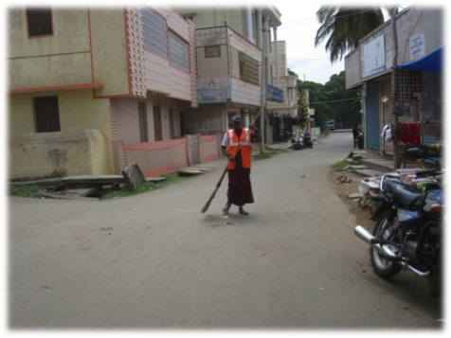
Same PK team does afternoon sweeping. Little waste ends on roads as their door-to-door collection covers every house

Slide 7
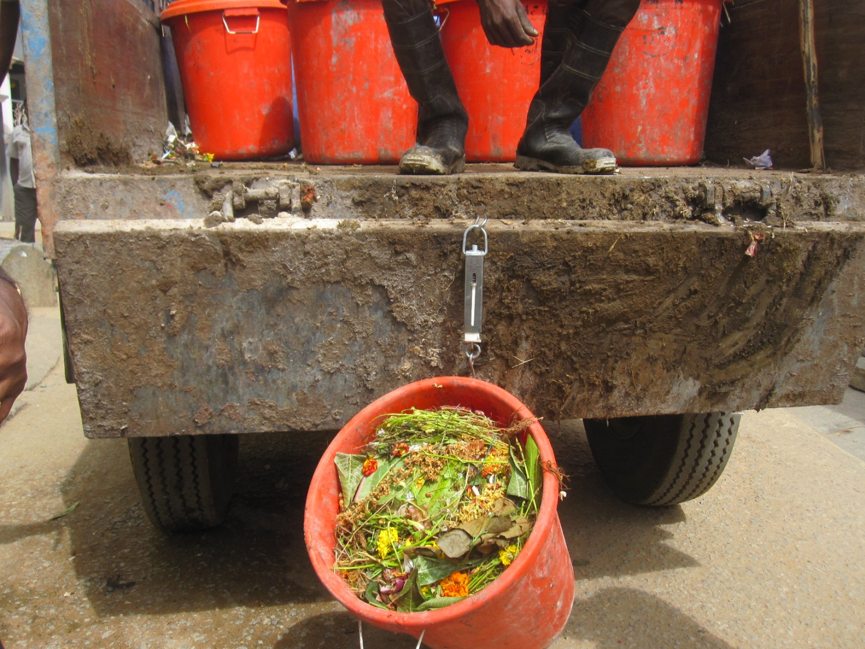
Tractors pick up Wet-waste bins and weigh each one before loading

Slide 8
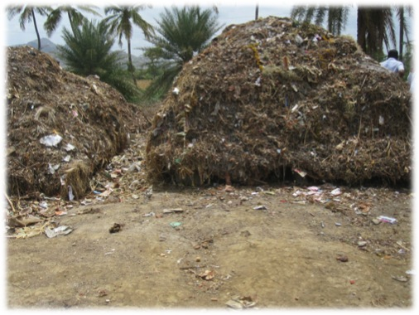
Tractors unload Wet waste directly in 9” layers on wood-frame stacks kept off the ground for self-aeration. No power labour or equipment needed

Slide 9
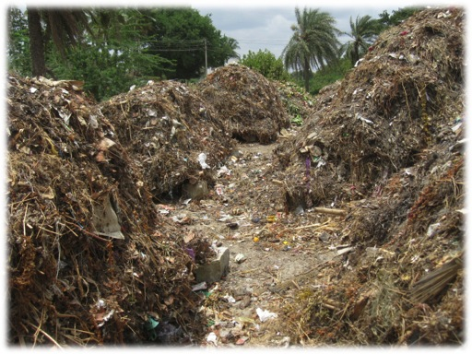
Stacks are auctioned as early as one month after maturing and transport teams share income with city

Slide 10
DAILY COLLECTION REQD ONLY FOR WET WASTE & Domestic Sanitary Waste (sanipads, diapers) to be dropped off at local hospitals for Biomed Waste pickup.
KEEP YOUR DRY WASTE FOR WEEKLY SALE or KACHRA DAAN Donation to Waste-pickers and earn blessings for your children.

Slide 11
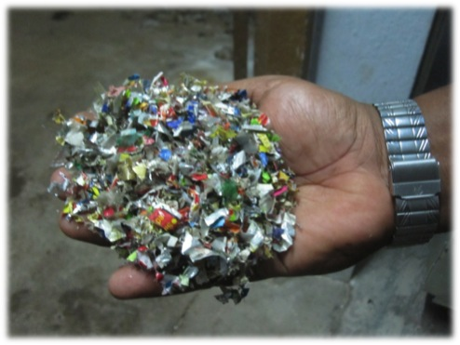
Unsaleable rejects like Kurkure chips pkts can be shredded to add to tar roads with doubled life

Slide 12
In Bangalore, Bulk generators like hotels, marriage halls and large apartmts must manage waste on-site. Options :
Biobins in garden or on terrace
Biogas units for on-site cooking for hotels, hostels
Pit or Stack composting for garden waste
Fuel pellets or briquettes for tender-coconuts
Plastics to diesel-like fuel (P2F)

Slide 13
USE LOCAL TALENT !
Aurangabad’s Mayo Vessels supplies Compost Plants to 26 cities
They can also do bio-miining at Naregaon to clear the site.
A V Mete is a major plastics recycler.
Briquetting is locally available, also in Pune.

Slide 14
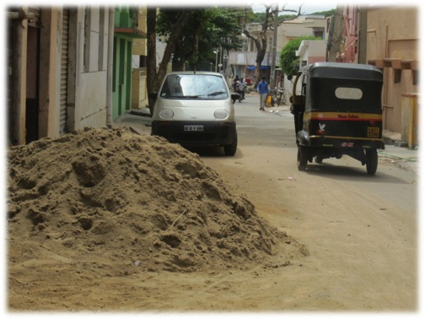
Avoid construction sand on roads

Slide 15
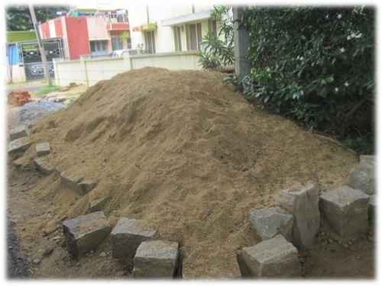
A ring of stones or sandbags keeps sand off road and saves wastage

Slide 16
CITY NEEDS A CITIZENS COMMMITTEE
It can bring Best Practices to Aurangabad
It can help keep Wet and Dry wastes unmixed
It can help create and implement a Debris Policy
It can support MERA AANGAN SAAF Rules where
every property owner is responsible for cleanliness
of their tiny stretch of footpath and drain
It can support decentralised waste mgt which will be more profitable for transport contractors and avoid future tax increases for citizens.
It will help create and ensure longterm 5-year policies.

